Slide 1
SparkSQL optimisation

Slide 2
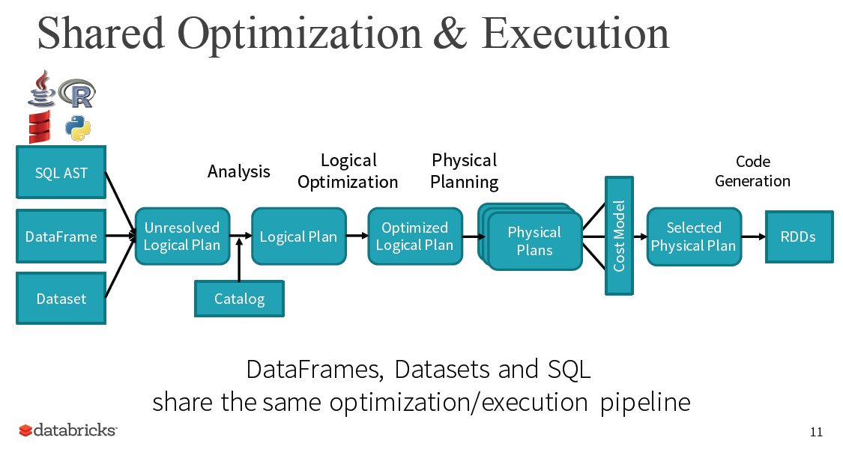
Note at the end the generated code uses the RDD API.
udfs
One of the major benefits of using structured data is that you can do optimization on it.

Slide 3
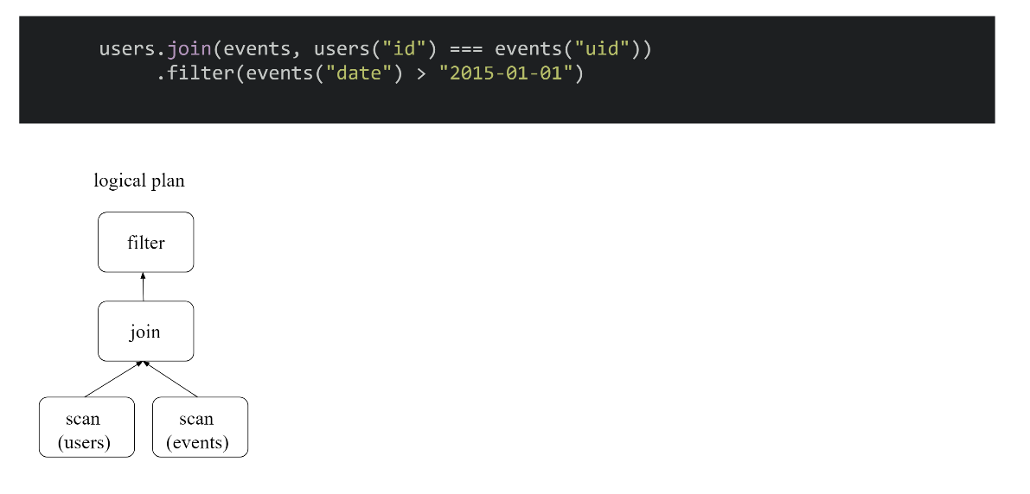
Why use a query optimizer?
This code above is very sub-optimal, since it does the join before doing the filter.
It is much better if we first do the filter and then do the join. Since the filter would first make the data much smaller. This means there will be less data shuffled across the network. Since doing the join requires shuffling the data.
Join is not efficient
Slide credit: http://scala-phase.org/talks/rdds-dataframes-datasets-2016-06-16/#/9

Slide 4
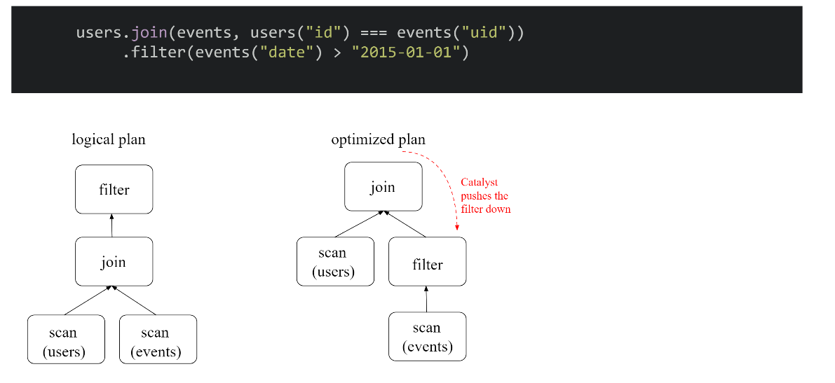
Why use a query optimizer?
The catalyst query optimizer creates an optimized plan which pushes the filter operation down the query tree.
Slide credit: http://scala-phase.org/talks/rdds-dataframes-datasets-2016-06-16/#/9

Slide 5
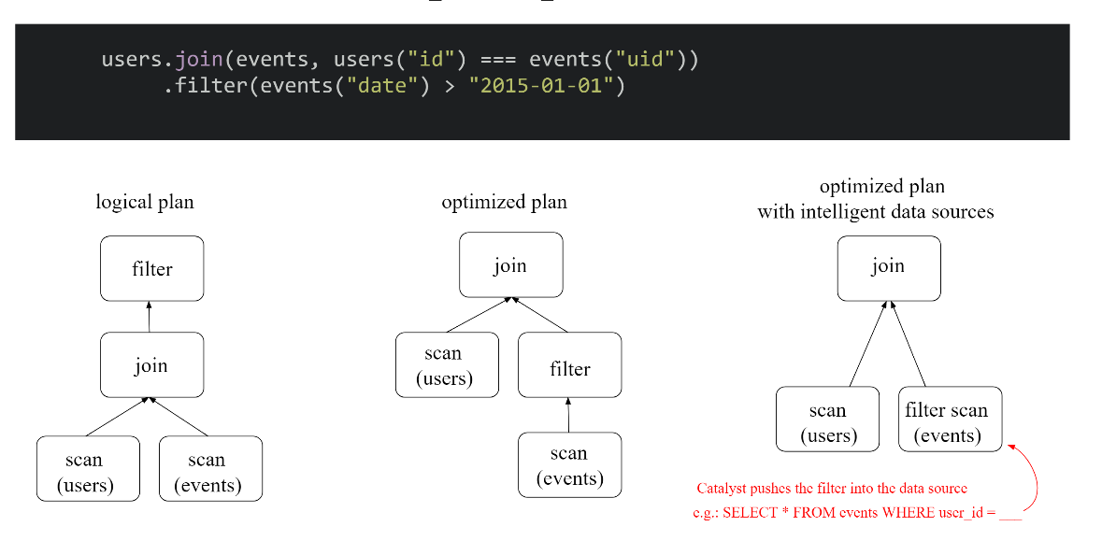
Why use a query optimizer?
Slide credit: http://scala-phase.org/talks/rdds-dataframes-datasets-2016-06-16/#/9

Slide 6
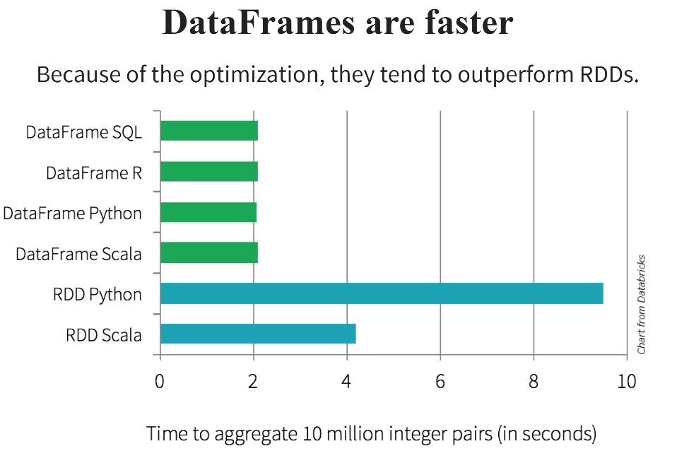

Slide 7
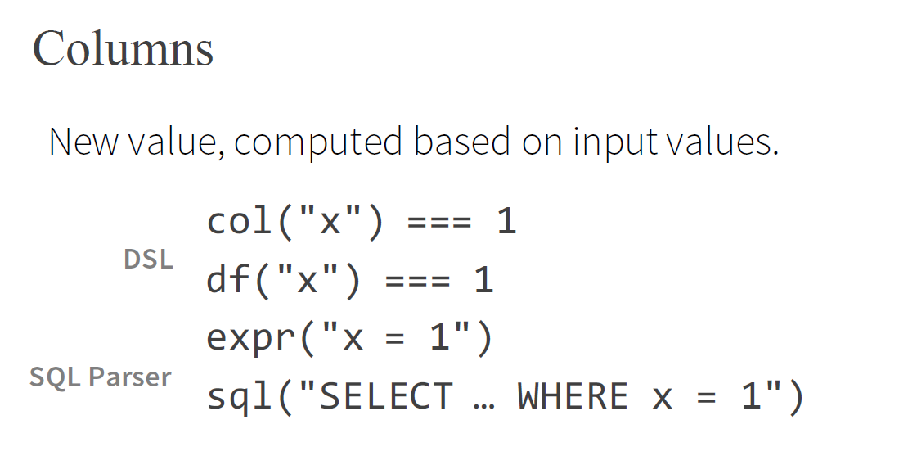
All of these translate to the same spark code
Can use expr(…) to write any SQL expression

Slide 8
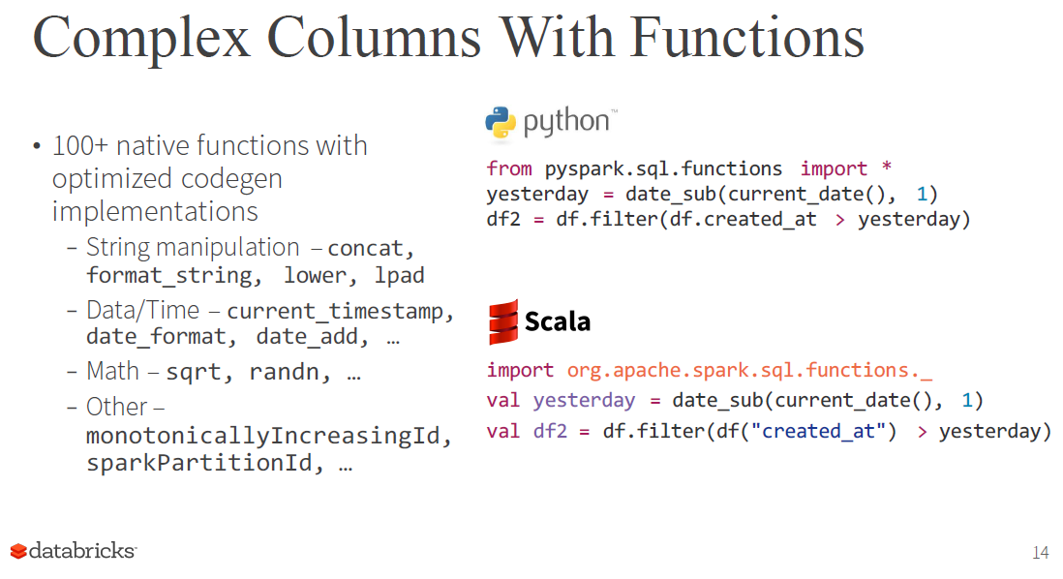
All the above functions can be used to generate highly optimized code at runtime by the optimizer
You can write a lot of different types of programs using the above functions. It offers a lot of flexibility.
If you use the above functions the python code is the same speed as the scala code.

Slide 9
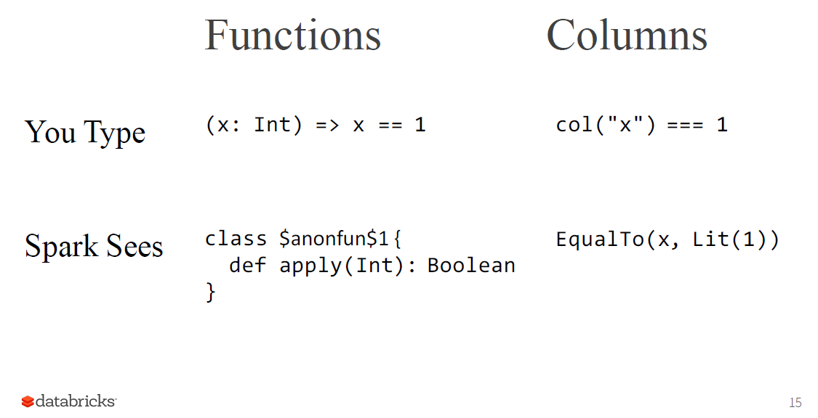
Scala lambda function
There is no optimization that can be done since spark just sees this function prototype
Spark can optimize this since it uses a spark function

Slide 10
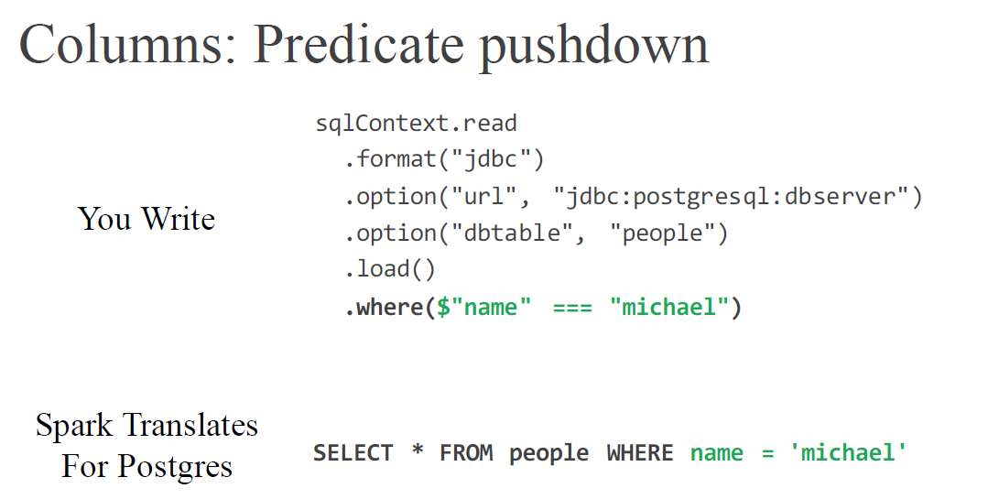
In the above example by using the .where clause in the code, we can get the postgres database to execute the where clause for use inside itself
This is much faster than if we had to do a filter operation in spark.

Slide 11
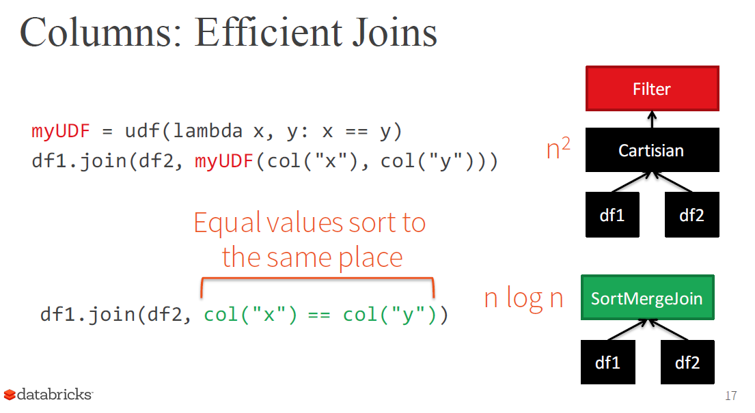
Spark can not optimize this since we wrote the logic in an udf, hence it needs to do a Cartesian product.
This code is much more optimized since we are using only spark functions. Hence spark can do much more efficient merge join

Slide 12
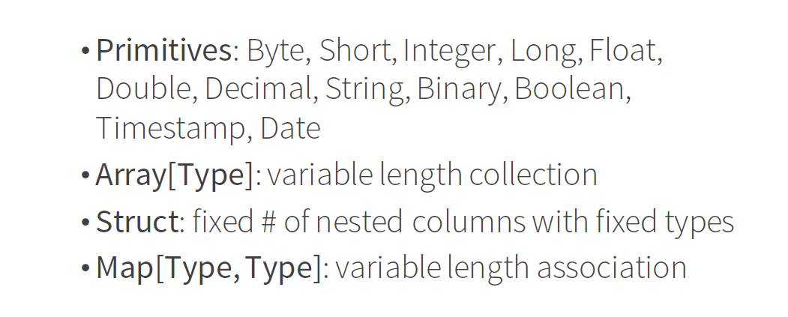
Spark’s own internal structure representation
case class Body(id: Int, width: Double, height: Double, depth: Double, material: String, color: String)
Spark maps data from any format into its own encoding.
E.g. case class Subject(id: Int, names: Array[String]) is mapped format as described below

Slide 13
Tungsten’s Compact Encoding
The aim of project tungsten is to optimize CPU and memory usage.
This only works with Dataframes and Datasets.
Spark understands the structure of data because they're typed
Spark uses encoders to translate between these types ("domain objects") and Spark's compact internal Tungsten data format.
The encoder actually generates code that does the conversion.
The conversion code is highly optimized and therefore can convert the data much faster than Java’s standard serializers
Generates custom byte code that is highly optimized for your particular situation.
Data in the internal format is highly optimized so it does compression and uses less memory

Slide 14
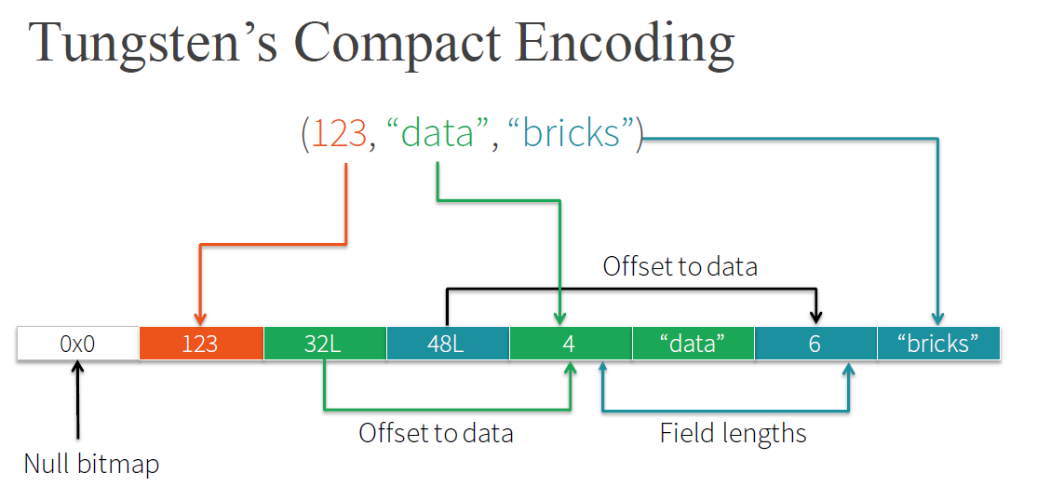
Takes structured data and produces a highly efficient encoded blob of bytes
This blob of bytes uses much less bytes of memory
Less data to shuffle across the network

Slide 15
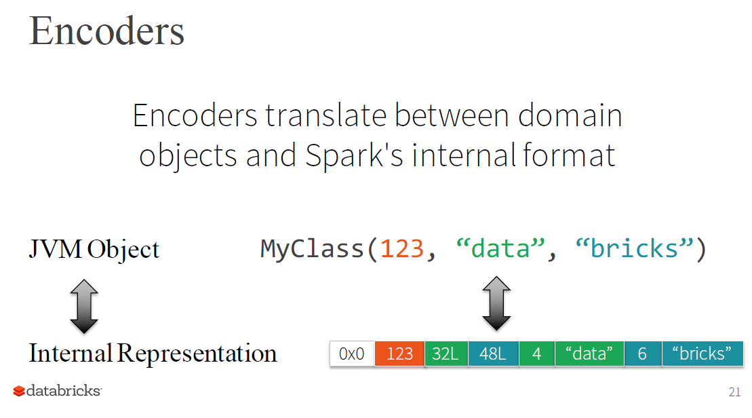

Slide 16
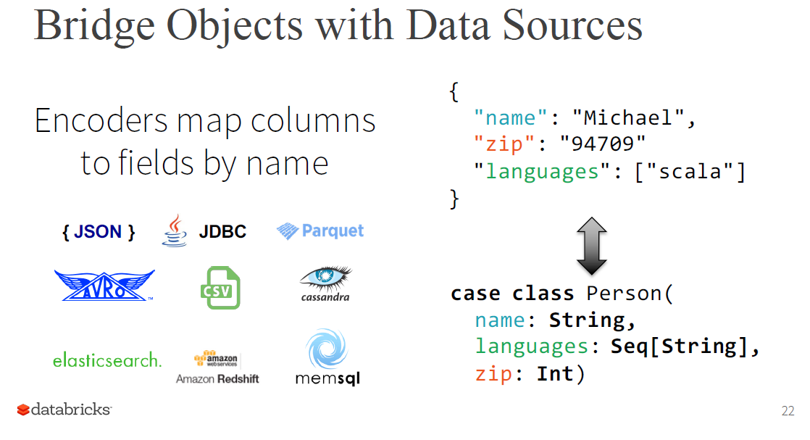

Slide 17
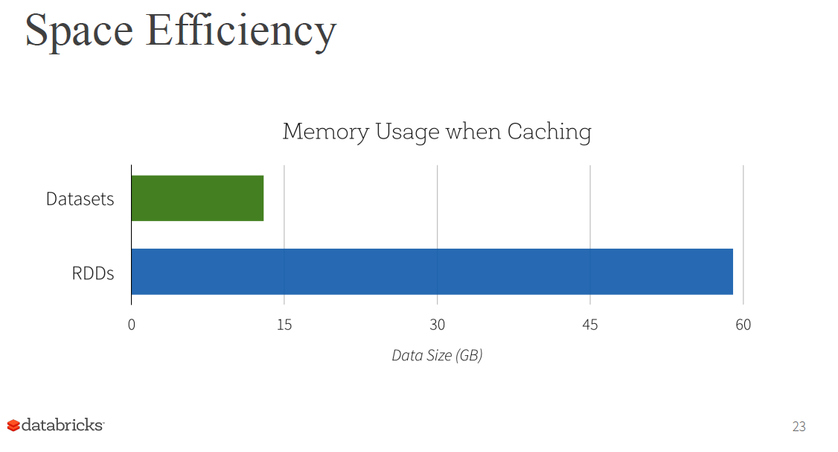

Slide 18
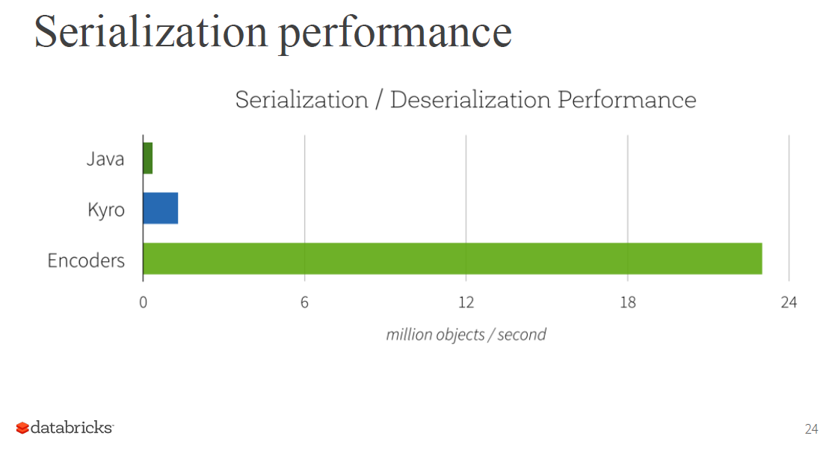

Slide 19
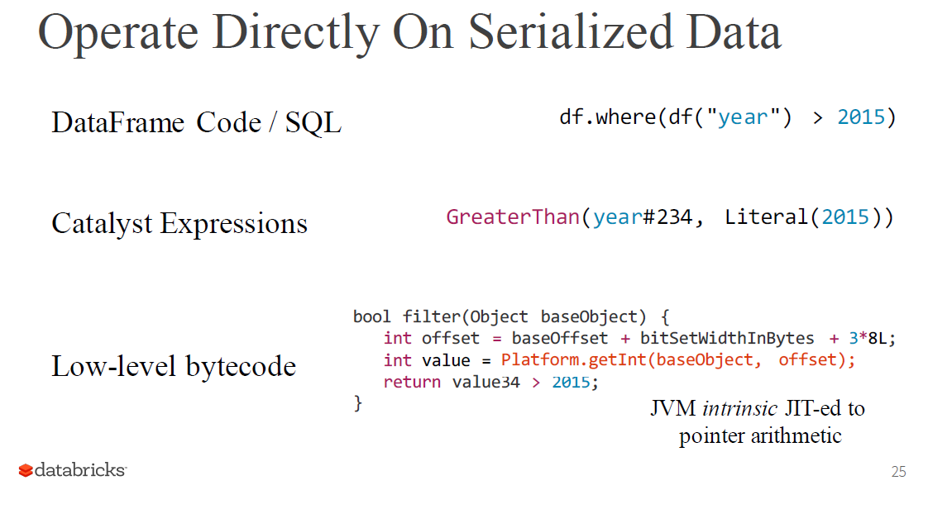
(optimizer)
Custom code generated for this example
No object creation or garbage collection
The generated code runs only 10% to 15% slower than optimized C++ code!!

Slide 20
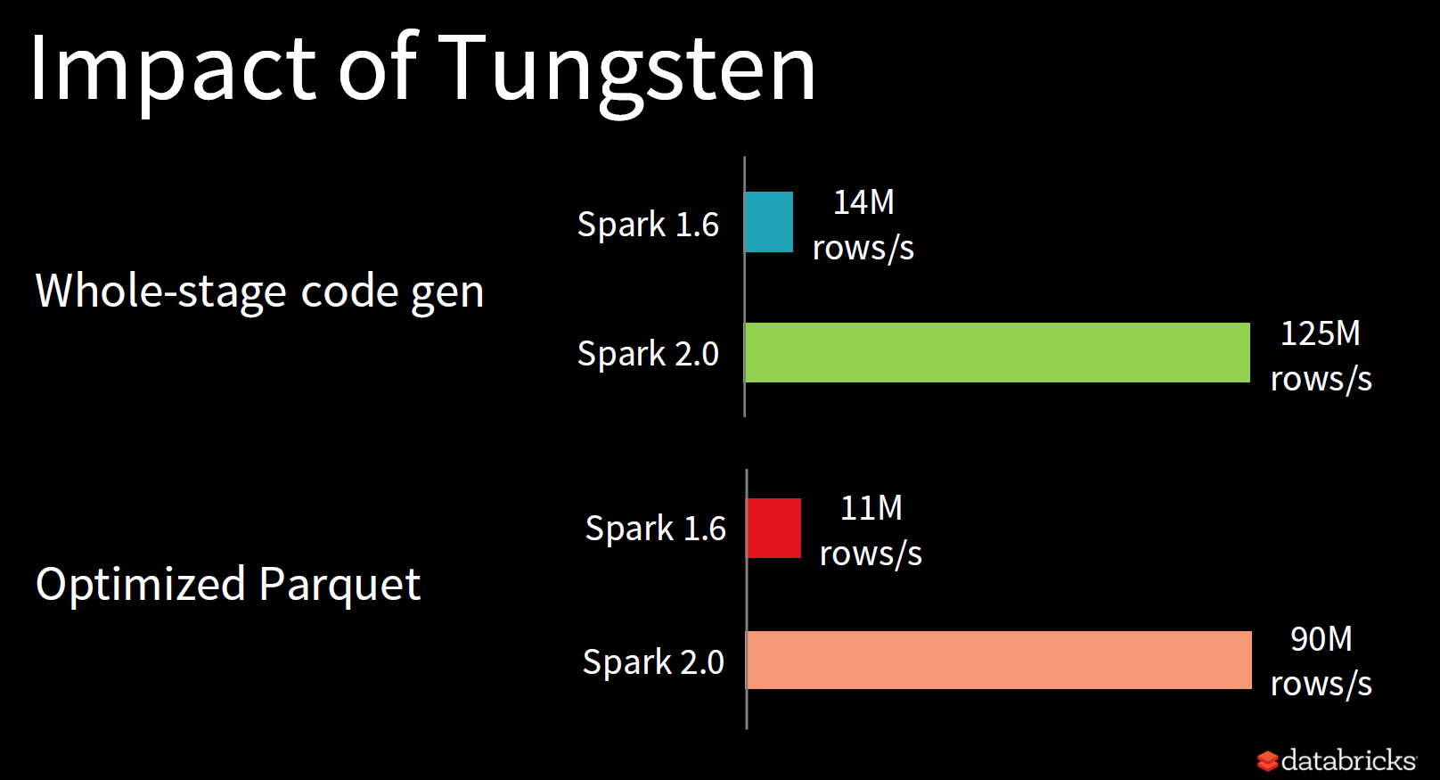
As you can see above the CPU optimization via Tungsten has a very large impact on performance.
The Parquet performance relates to the performance when converting data into the compact column oriented storage format.

Slide 21
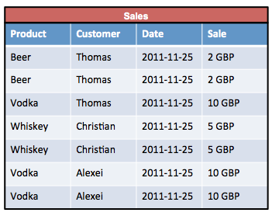
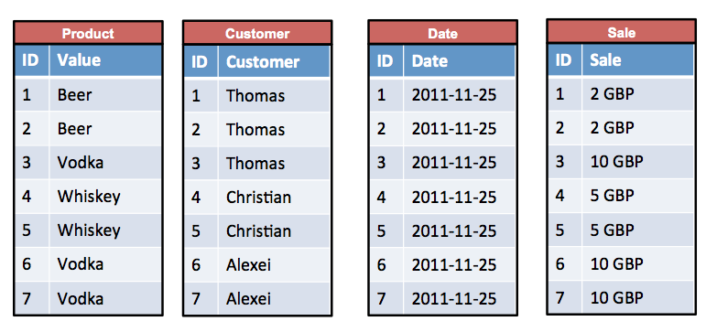
Efficient Storage: Parquet Format
Row format
Column format
Diagram source: http://kejser.org/how-do-column-stores-work/
Spark SQL allows data to be stored in column format.
Each column is stored in a different partition.

Slide 22
Why column format?
Row format
Column format
Diagram source: http://kejser.org/how-do-column-stores-work/
A lot less data need to be loaded
Many companies have tables with many columns (e.g. 100s of columns).
Storing the data in row format would mean you need to load all the data even if you only want data from two columns.
Using column format you only need to load the columns that you query.
For example if we want all the records for the customer and sale columns in row format you would need to load all the data. But if the data is in column format you only need to load the customer or sale columns.

Slide 23
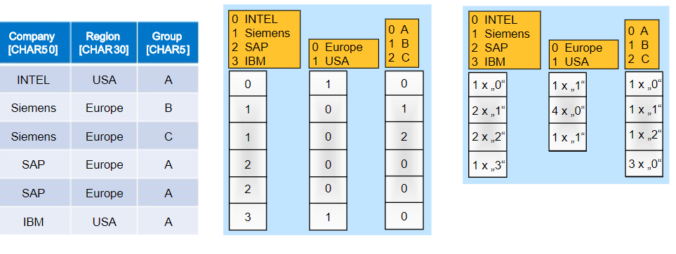
Why Column Format?
Original data
Dictionary encoded data
Run length encoded data
Storing data column wise allows you to better compress the data.
In the labs you will see that data stored in Parquet format is very small
For example in the example above we can use run-length encoding of the data in each column to reduce the size of each column.

Slide 24
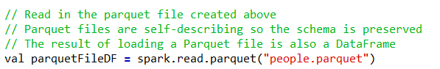


Parquet Format
The above example shows how to load data that is stored in parquet format into a dataframe. Note no schema needs to be specified since it is already stored in the parquet file.
The above shows how to load a parquet file into a dataset.
When you save the data in parquet format it also saves the schema in the parquet file

